Slide 1
NoTE CARDS ARE YOUR FRIEND!
How note cards can help you organize your research and simplify your life

Slide 2
Note taking
1 Resource cards: (your citations) Day, R.A. (2001) How to write & publish a scientific paper (4th ed.) Phoenix, AZ: The Oryx Press. (You should have 6 of these cards, one for each source)
Note cards: 1 - Information from the text - Key facts and quotes from your source Only includes information from one source The numbers on the note card should match the number on the resource card where you found the information - Include a page number so that it is easier to refer back to the information
USE CITATION MACHINE AND FIND THE FORMAT FOR YOUR SOURCE BEFORE YOU WRITE IT DOWN ON YOUR REFERENCE CARD
Using a different colored index card or a highlighter is a great way to organize your work.
Write each of your sources on a note card. Write a number in the right hand corner for each source.
Use only one note card per source.

Slide 3
Paraphrase (What?!?)
A paraphrase is...
your own interpretation of essential information and ideas expressed by someone else, presented in a new way.
one legitimate way (when accompanied by accurate documentation) to borrow from a source.
a more detailed restatement than a summary, which focuses concisely on a single main idea.
In-text citations must be used when you paraphrase.

Slide 4
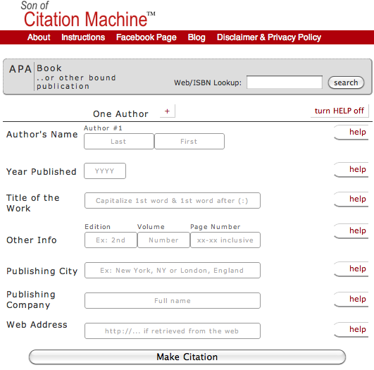
6 Steps to Effective Paraphrasing
Reread the original passage until you understand its full meaning.
Set the original aside, and write your paraphrase on a note card.
Write down a few words below your paraphrase to remind you later how you plan on using this material. At the top of the note card, write a key word or phrase to indicate the subject of your paraphrase.
Check your work with the original to make sure that your version accurately expresses all the essential information in a new way.
Use quotation marks to identify any unique term or phraseology you have borrowed exactly from the source.
Record the source (including the page) on your note card so that you can credit it easily if you decide to incorporate the material into your paper.

Slide 5
Quotations, Paraphrasing and Summarizing, OH MY!
These three ways of incorporating other writers' work into your own writing differ according to the closeness of your writing to the source writing.
Quotations must be identical to the original, using a narrow segment of the source. They must match the source document word for word and must be credited to the original author.
Paraphrasing involves putting a passage from source material into your own words. A paraphrase must also be credited to the original source. Paraphrased material is usually shorter than the original passage, taking a somewhat broader segment of the source and reducing it slightly.
Summarizing involves putting the main idea(s) into your own words. Once again, it is necessary to cite summarized ideas to the original source. Summaries are significantly shorter than the original and take a wide overview of the source material.

Slide 6
How to cite Internet sources (APA format)
WEB SITE
Citing an entire web site
If you reference an entire Web site (rather than a specific document on the site), you may just give the address (URL) in the text. No works cited entry is needed.
(http:myproject.org)

Slide 7
Continued…
An article from an online journal
Author. (date of article). Article title.
Journal Title, vol. (issue), pages.
Date information retrieved, from
URL
Jacobsen, J.W. (2001). A history of
facilitated communication. American
Psychologist, 50(2), 750-752. Retrieved
August 25, 2001, from
http//www.apa.org/journals/
jacobsen.html

Slide 8
DOUBLE SPACE citations in your bibliography
An article from an online newspaper
Author. (Year, Month Day). Article
title. Newspaper Title. Date
information retrieved, from
URL.
Pear, R. (2003, January 2). Gains reported
for children of welfare to work families.
The New York Times on the Web.
Retrieved January 4, 2003, from
http://www.nytimes.com/2003/01/2/
WELF.html.

Slide 9
Citation Machine for books

Slide 10
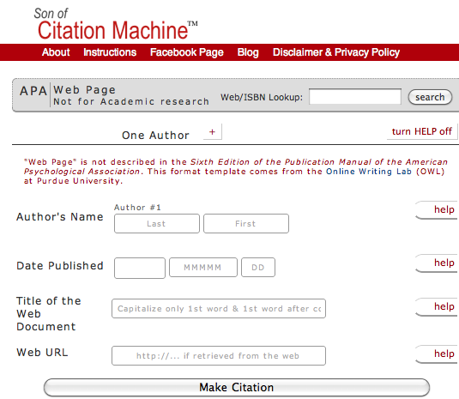
Citation Machine for web pages

